Slide 1
COVID-19 Site Survey
June 2020 – Sudan

Slide 2

Agenda
About the Task Force
Methodology
How to access the Survey
Survey objectives
Recommendations
Results

Slide 3

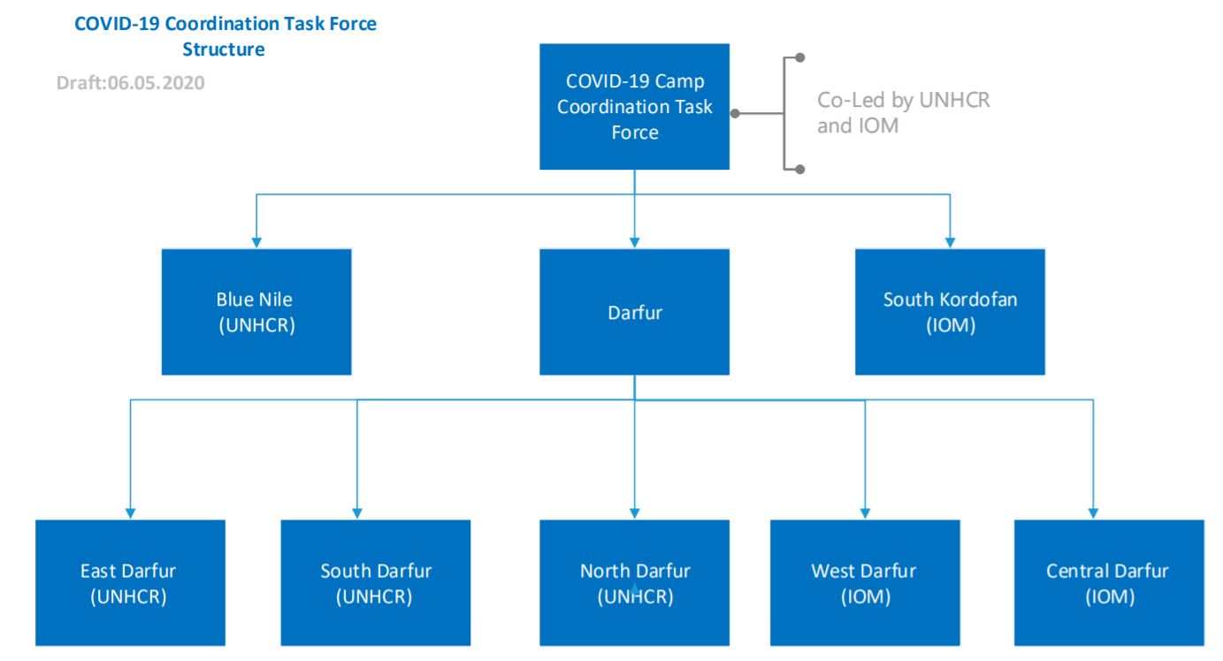

About The Task Force
You can find the ToR on the TF web page

Slide 4


Methodology
Who fills the survey?
The survey is filled by Lead Agency staff, outlining each site/camp's details.
This is not a survey to be filled by a KII (community representative, Sheikh/Umda) or through Focus Group Discussions
You can always call another agency to verify or consult on a question/information in case of uncertainty
How many surveys should you submit?
For each site/camp one survey should be submitted.
What is the survey frequency?
The survey per site/camp should be submitted once per month. Deadlines will be communicated by the Task Force.

Slide 5
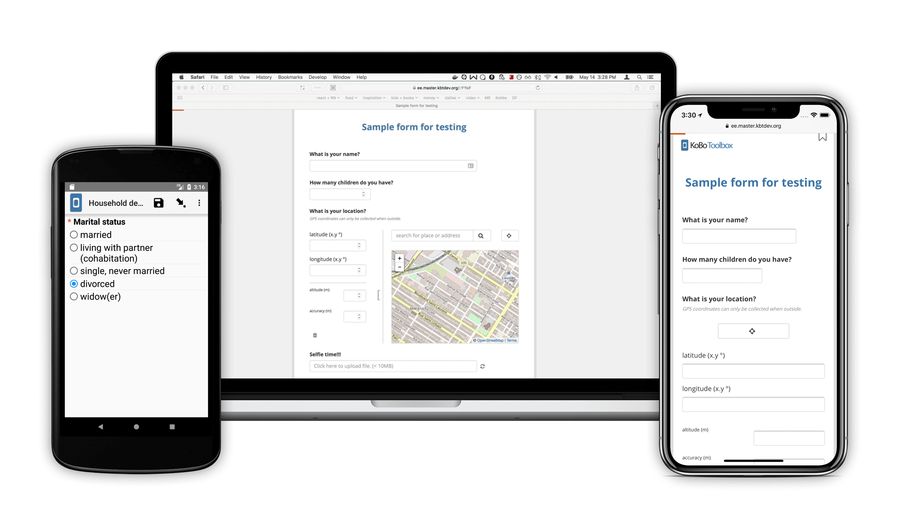
How to access the Survey
The link works on Google Chrome Browser
For the current exercise we will use the Desktop Link and can change to Mobile. Please contact the focal point in your area for the link.
Mobile
Desktop

Slide 6

Survey Objectives
Collect Data on
Site/Camp Details
Collect data on Available COVID-19 resources
Collect data on Available
Service Providers
Messaging and Data available on COVID-19
Health and WASH facilities
Are there any stigmas? Risk mitigation?
Health
WASH
Shelter/NFI
Education
Food security
Protection
Details on site location
Leading Agency
Population groups
Population demographics

Slide 7

Recommendations
Pay attention to the questions
Check the hints
If an error happens, Don’t Panic and re-read the question with the hint
Read the questions before filling and ask relevant actors/colleagues for information
Feel free to contact the Task Force if you are unsure about something

Slide 8

FAQ
What if I don’t have access to internet when I am in the camp, how can I fill the survey form?
  Bookmark the survey link on your Google Chrome Browser; Fill the survey ; Save as a draft; Submit the survey once you have internet access
  Use a paper version and re-fill it online once Internet available (you can select to print a copy of the survey form)
I have a desktop computer, how can I fill the form?
  If you have a smartphone you can use the internet browser on your phone.
  You can use a paper version and fill the online form when you are back at your desktop computer.
What if I have started filling the form online, but am not able to complete it all at the one time – can I save it and continue filling the form later?
You can save the form as a draft and upload it later
How can I get the GPS coordinates, if I cannot reliably collect them through Kobo (for example, I am filling the form in the office)?
  If you face difficulties or are not at the site/camp, copy/paste coordinates from Google maps
  The GPS function does work offline, so you can take coordinates offline whilst in the site/camp - just check the accuracy.

Slide 9


Results
Results will be published on
https://cccmcluster.org/operations/Sudan
In case of issues with the data, we may contact the Lead Agencies for clarification

